Slide 1

Team Name : CODESSSS
Team Details: Aayani Verma Jiya Rajwanshi Riya Mathur

Slide 2
Problem Statement
Engagement on a shopping platform:
Problem Statement: Enhancing Online Apparel Shopping with Virtual Trial Rooms
Objective: Develop a virtual trial room solution that allows users to try on clothes virtually before making a purchase on the clothing website.
This solution will enable users to virtually try on clothes, offering a realistic and interactive fitting experience.
By incorporating advanced technologies such as augmented reality (AR) and 3D modeling, the platform will accurately simulate how garments will look and fit on diverse body types.
Additionally, the system will integrate seamlessly with existing e-commerce platforms, providing a smooth and intuitive user interface.

Slide 3
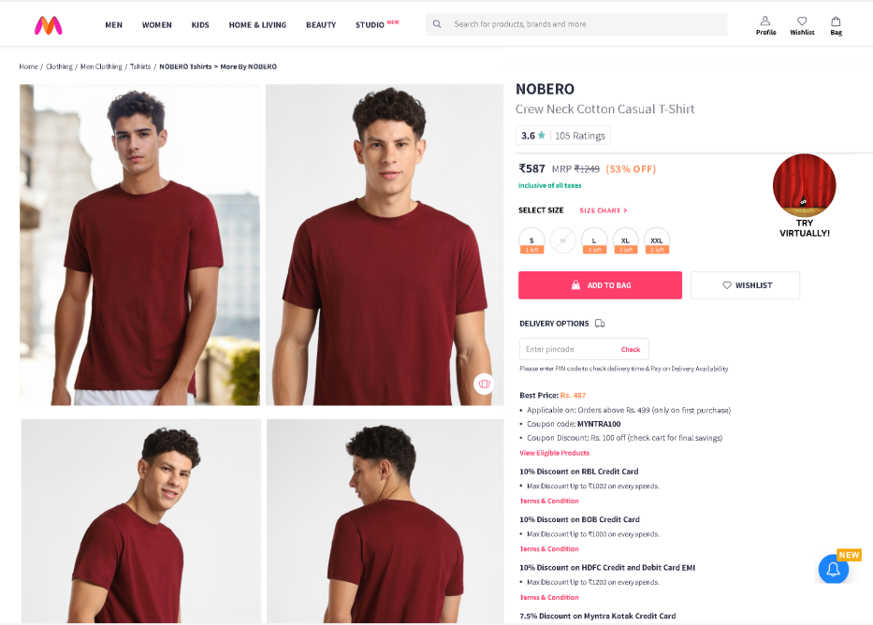

Prototype

Slide 4
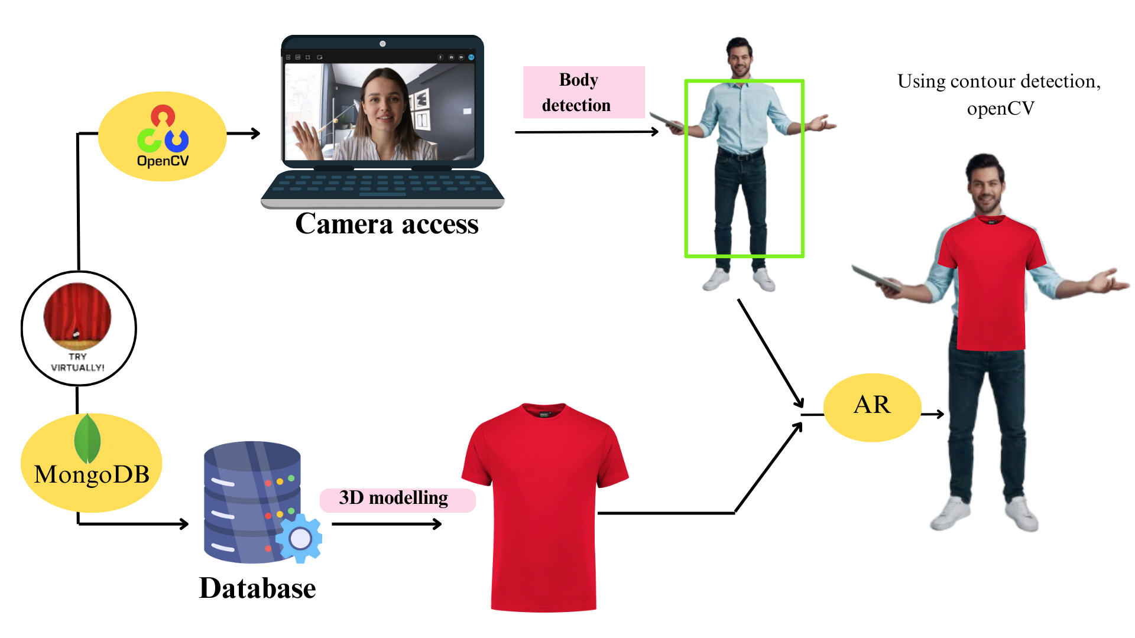
Solution

Slide 5
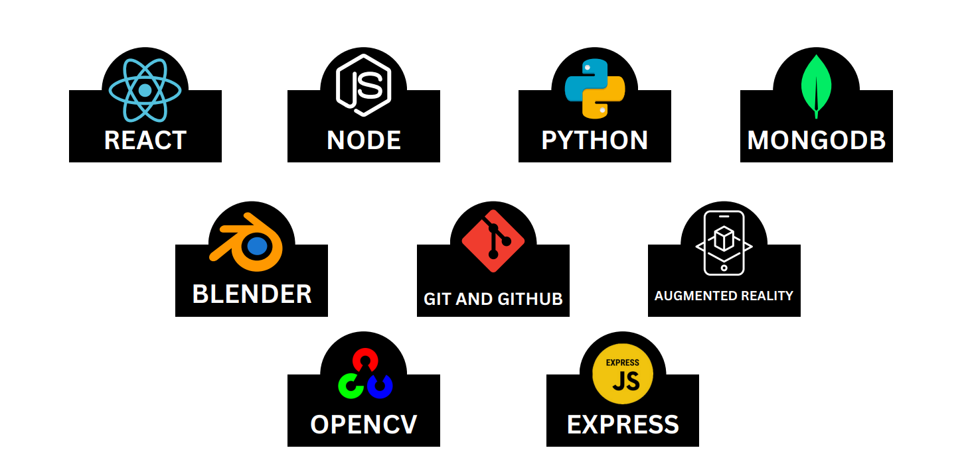
Tech Stack

Slide 6
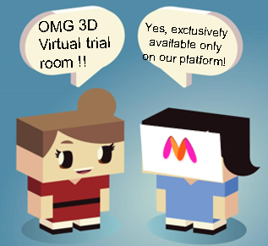
Benefits
AR and virtual fitting create interactive shopping experiences, boosting customer interaction and emotional connection with products.
Virtual try-ons increase purchasing confidence, leading to higher conversion rates.AR enhances upselling opportunities by suggesting complementary products during virtual fittings, boosting average order values.
Exclusivity
Enhanced customer engagement
Increased Sales
Virtual fitting reduces return rates by allowing customers to assess fit and style before purchase reducing sizing desc.
Streamlined shopping experiences with AR reduce decision-making time, enhancing convenience for shoppers. Accessibility to virtual fitting technology accommodates diverse customer preferences and enhances overall shopping convenience.
Reduced Returns
Convenience

